Slide 1

DEPARTMENT OF INSTRUMENTATION AND CONTROL ENGINEERING
MANIPAL INSTITUTE OF TECHNOLOGY
Manipal Academy of Higher Education
Design and Implementation of Non-linear Model Predictive controller for a Non-linear Model of Quadrotor
By:
Sriram .T
Reg.NO: 170921136
Section: B
Dept. of Instrumentation and Control Engineering,MIT,
Manipal
Under the guidance of,
Dr.I Thirunnaukkarasu
Associate professor (Senior scale)
Department of Instrumentation and Control

Slide 2
Contents
Introduction
Need for the project
Objective
Methodology
Controller Design
Matlab simulation
Software and hardware used
References

Slide 3
Introduction
Control of vehicle motion is achieved by altering the rotation rate of one or more rotor discs, thereby changing its torque load and thrust/lift characteristics.
Quadcopter is a device with a intense mixture of Electronics, Mechanical and mainly on the principle of Aviation.
The Quadcopter has 4 motors whose speed of rotation and the direction of rotation changes according to the users desire to move the device in a particular direction (i.e Takeoff motion, Landing motion, Forward motion, Backward motion, Left motion, Right Morion)
The rotation of Motors changes as per the transmitted signal send from the transmitter.
The program for which is written in the 32-bit ARM Cortex M4.
The signal from microcontroller goes to ESC’s which in turn control the speed of motor.

Slide 4
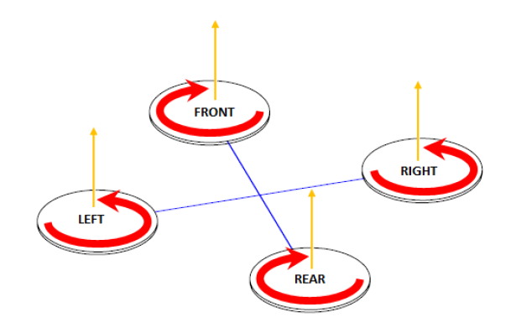
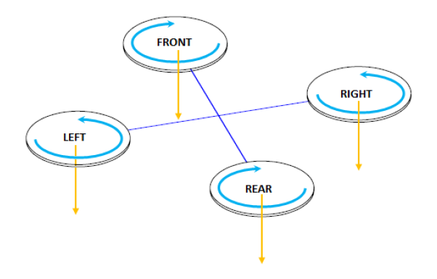
Motor Rotation
Take off Motion
Landing Motion
Source: Google images

Slide 5
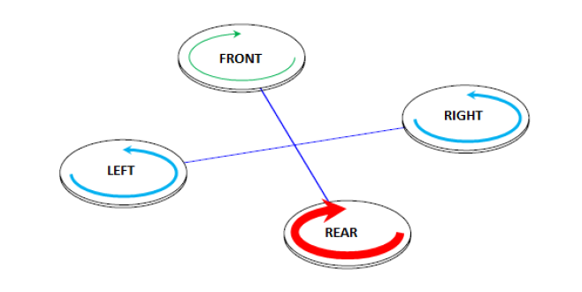
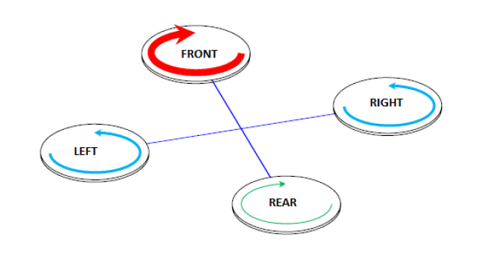
FORWARD MOTION
BACKWARD MOTION
Source: Google images

Slide 6
Need for Controller Design
The need for proper controller design is crucial for quadrotor has it contains non-linear dynamics.
For this reason the project work consists of implementing an effective advanced controllers such as non-linear model predictive control and Sliding mode control to carry out desired trajectory tracking and compare the results between the two controllers
Going through past literature reviews there has not been many works published on Non-linear model predictive control for quadrotor. This is a prime motive to carry out this project on hardware implementation

Slide 7
Need for the project
Quadrotors are employed in a wide array of applications ranging from medical to transportation industry, to list a few:
Verifying/Checking accidents on roads:
Quadrotors/drones are employed to check where exactly a accident has occurred in areas which has restricted access.
https://www.youtube.com/watch?v=y-rEI4bezWc&feature=emb_title
Organ transportation:
There’s a huge demand for cost effective and secure transportation of many other medicinal materials; for example, blood for transfusion, organs for transplant and clinical samples for testing and pathology.
Many hospital services have been centralized or facilities have expanded into new regions, the logistical requirements and transportation of these materials is an ever-growing challenge.

Slide 8
The quality and stability of a biological sample is sensitive to the length of time it is in transit thus, geographically-challenging locations requiring long and circuitous routes and urban areas that are vulnerable to unpredictable journey times due to excessive congestion in rush-hour traffic, makes the transportation of blood units, organs and other clinical samples difficult within their required arrival times.
Delivery of packages:
E-commerce companies have adopted drones to deliver goods from warehouse to main destination locations near the cities where delivery agents could pick-up and deliver the goods to nearby locations.
This way the traffic congestion is reduced and goods are delivered swiftly.

Slide 9
Objective
To design a Non linear Model predictive controller to perform trajectory tracking.
To develop a Matlab code for the Non-linear model predictive control
To convert the Matlab code to embedded C code.
To test the embedded C code for implementing it in a hardware.

Slide 10
Methodology
The dynamical system consists of 12 states ,4 inputs and 6 outputs.

Slide 11
Dynamical Model of quadrotor
The motion of the quadrotor can be divided into two subsystems; rotational subsys-tem (roll, pitch and yaw) and translational subsystem (altitude and x and y position).
The rotational subsystem is fully actuated while the translational subsystem is un-deractuated .

Slide 12
Inertia Matrix
The inertia matrix for the quadrotor is a diagonal matrix, the oﬀ-diagonal elements, which are the product of inertia, are zero due to the symmetry of the quadrotor.
Where I_{xx}, I_{yy} and I_{zz} are the area moments of inertia about the principle axes in the body frame.

Slide 13
Moments Acting on the Quadrotor (M_{B}):
For the last term of equation (1), there is a need to deﬁne two physical eﬀects which are the aerodynamic forces and moments produced by a rotor.
As an eﬀect of rotation, there is a generated force called the aerodynamic force or the lift force and there is a generated moment called the aerodynamic moment.
[1]

Slide 14
A simplified equation for moment and force produced by i^{th} can be given as:
l – moment arm

Slide 16
State space model

Slide 17
U1 is the resulting upwards force of the four rotors which is responsible for the altitude of the quadrotor and its rate of change (z, z˙).
U2 is the diﬀerence in thrust between rotors 2 and 4 which is responsible for the roll rotation and its rate of change (φ, φ˙).
U3 on the other hand represents the diﬀerence in thrust between rotors 1 and 3 thus generating the pitch rotation and its rate of change (θ, θ˙).
U4 is the diﬀerence in torque between the two clockwise turning rotors and the two counterclockwise turning rotors generating the yaw rotation.
If the rotor velocities are needed to be calculated from the control inputs, an inverse relationship between the control inputs and the rotors’ velocities is needed, which can be acquired by inverting the matrix in the above equation to give:

Slide 19
Rotational Equations of motion

Slide 20
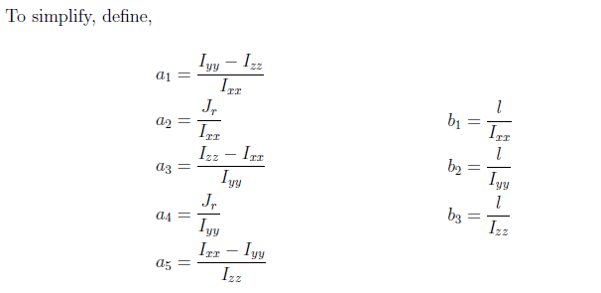
[1]

Slide 21
Translational equation of motion
Substituting equations 9 in 8 , the equation of the total moments acting on the quadrotor becomes

Slide 22
The nonlinear model of the quadrotor is then used to implement a controller with input, output and state constraints.
A cost function is used (discrete algebraic Riccati equation) to minimize the actuation and control signal.
The quadratic cost function is minimized by using quadratic programming(QP).
Simulation of the model is done using Matlab Simulink software.
The simulink model is converted to C code using targetlink/ Matlab code generator and it is then implemented onto a flight controller (Phikhawk) for test flight.
Specification of Phikhawk 2.0
Processor
32-bit ARM Cortex M4 core with FPU
168 Mhz/256 KB RAM/2 MB Flash
32-bit failsafe co-processor

Slide 23
Constraints
Why does the quadcopter system needs constraints ?
Since, the quadcopter can only produce bounded forces and that too only along one direction, the platform must be input constrained
Also the quadcopter is constrained in operation in state-space, therefore there must exist state constrains on the system

Slide 24
Constraints on angle:
Given the nature of quadrotor, the range of operation of the vehicle is explained below:
Input and state constraint handling:
Now attention is given to constraint handling capabilities of the NMPC problem formulation after the cost function is described:
It is necessary to constraint both:
Total thrust force on each rotor
Restrict the magnitude of the angles in order to stay within the limits allowed by Euler angles formulation discussed before

Slide 25
Input constraints:

Slide 27
State constraints
It is also of high importance to limit the angles so that no kinematic singularities are encountered due to the limitations in the model description.
In case of the quadrotor, the angles need to be within the bounds specified earlier

Slide 28
Where Delta u is the constant force required to keep the quadcopter balanced

Slide 29
Cost Function:
The cost function is chosen in such a way that predicited outputs derived from the predicition horizon ,are driven to a desired state and at the same time it should minimize the controller effort required.

Slide 33
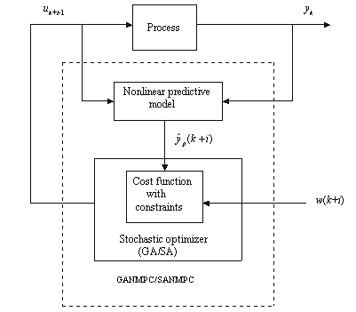
Controller Design
A general closed-loop system with no disturbances or noise can be represented in a block diagram such as in figure below
In our case, being the controller based in the NMPC method, the full state set of the quadrotor is required, which would make necessary the use of an state estimator. However, it will be assumed that all states of the quadrotor can be accessed and therefore no observer will be designed.

Slide 34
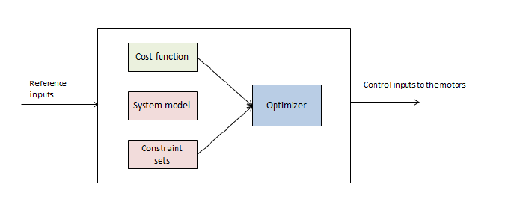
The controller of the quadrotor is designed by using Nonlinear Model Predictive Control. Therefore, the structure of the controller can be depicted in Figure below

Slide 35
NMPC Definition
Once selected the mathematical model for the quadrotor rigid body, having defined the structure of the controller the NMPC problem has to be defined. The structure of a general MPC problem consists in the computation of control inputs that minimize a cost function, subject to a certain set of constraints that includes the control oriented model of the system, over a certain prediction horizon N . This translates into the following algorithm for a basic NMPC:
Measure the state x(n) of the system (or real model, in our case).
Set x0 = x(n), solve the Optimal Control Problem

Slide 36
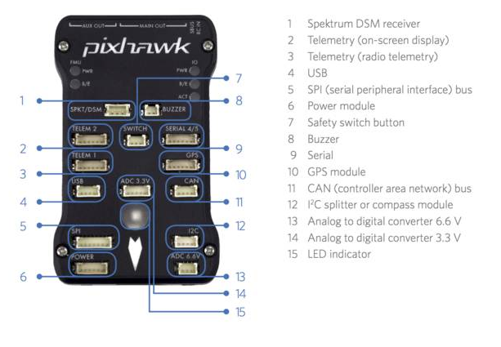
Overview of Flight Controller (Phikhawk)
Source: Google images

Slide 37
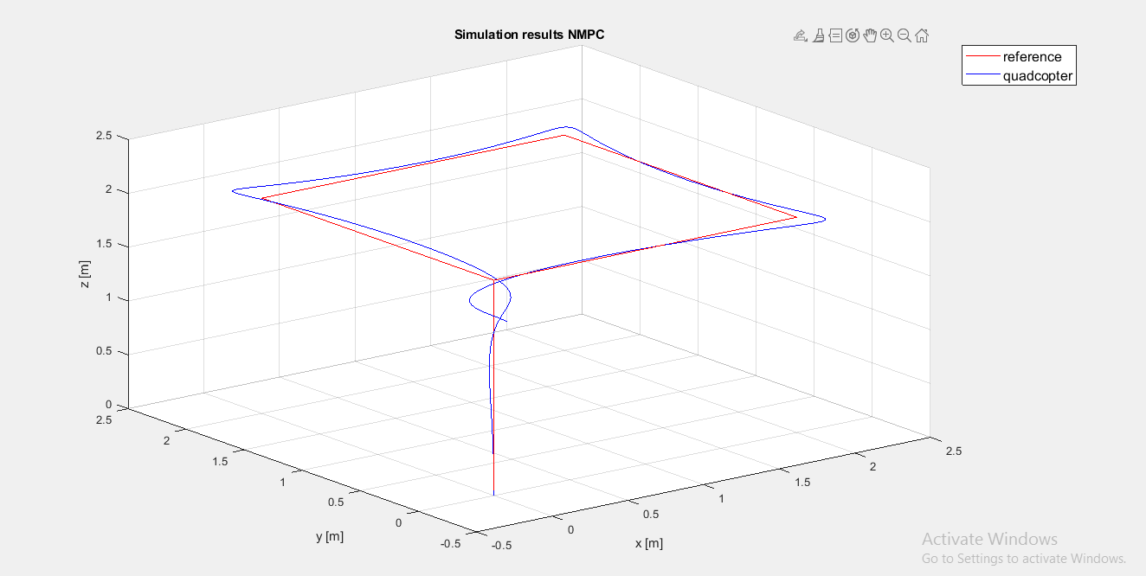
Matlab Simulations

Slide 38
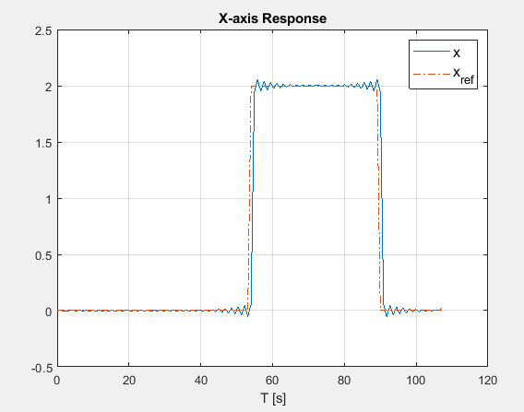
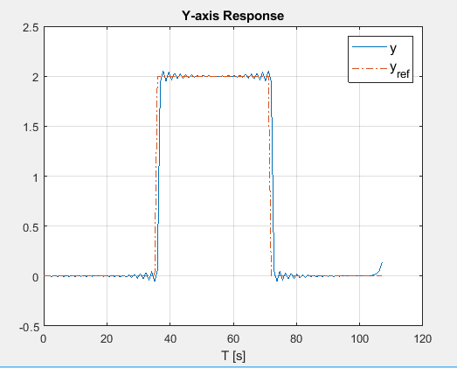
System position response plot in the X-axis for the NMPC controlled system with rectangular reference trajectory
System position response plot in the Y-axis for the NMPC controlled system with rectangular reference trajectory

Slide 39
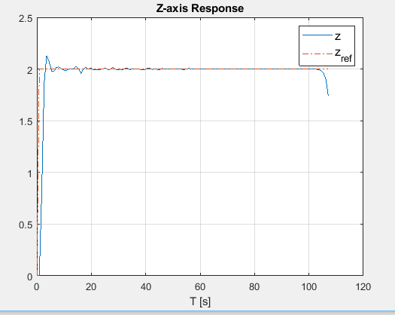
System position response plot in the Z-axis for the NMPC controlled system with rectangular reference trajectory

Slide 40
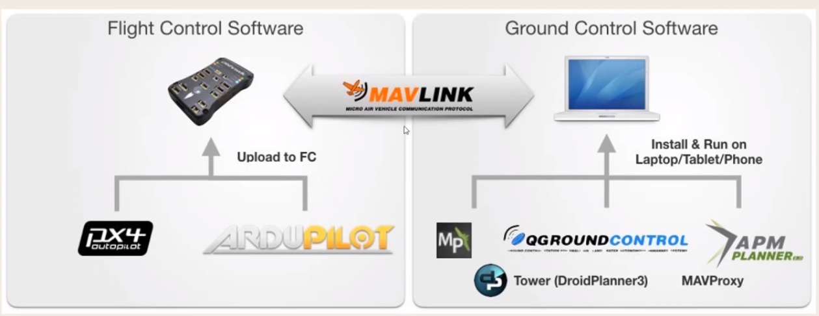
Hardware and Software used
Phikhawk 2.2 Cube
MavLink
Ardupilot (Firmware)
Mission planner
Qground Control
Matlab/Simulink

Slide 41
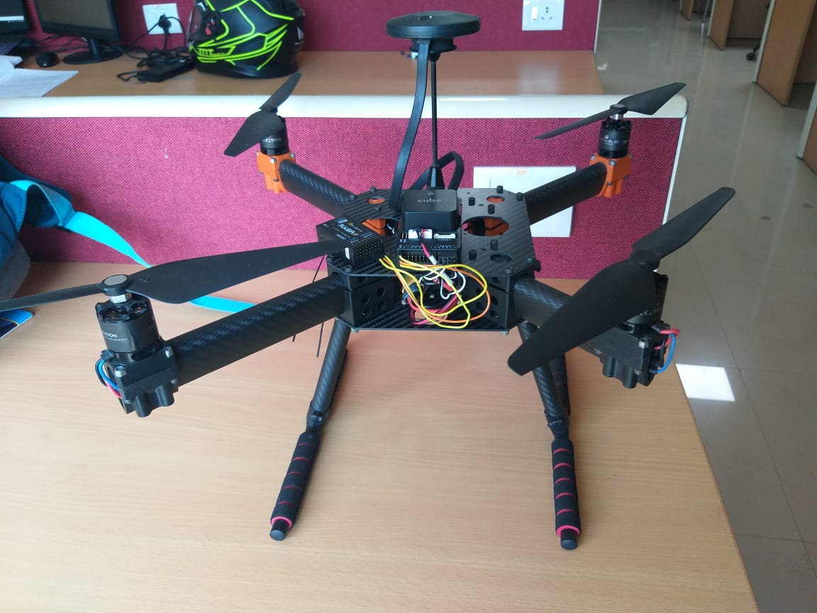
Complete setup of the quadrotor

Slide 42
Conclusions
The results obtained were satisfactory in terms of trajectory tracking.
In this project, it has been shown that the use of NMPC to control a quadrotor is able to guarantee stability and feasibility and provide a considerably good performance.
This have been the case for simple reference inputs as well as for complete path tracking, and considering an ideal model for the quadrotor, as well as considering a real model with added effects with respect to the control model.

Slide 43
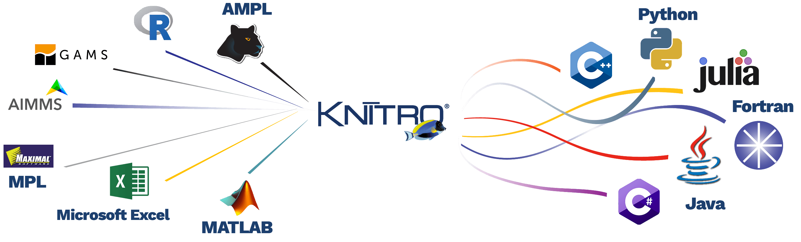
Future Work
However, the major drawback of this approach remains after the conclusion of this project, which is the inability to obtain real-time control. Even after several attempts to minimize the time ratio, the best obtained value, considering the unmodelled dynamics and wind disturbances.
Therefore, any future work should focus on obtaining real-time control. This could be approached by considering the use of a commercial and more powerful nonlinear optimization solver, such as Knitro from Artelys and/or the use of a PC with a more powerful microprocessor.

Slide 44
References
Pengkai Ru and Kamesh Subbarao , ‘Nonlinear Model Predictive Control for Unmanned Aerial Vehicles’, Flight Mechanics Conference, AIAA Aviation Forum, Dallas, TX, USA, 22–25 June 2015; Kamesh Subbarao, Carlos Tule and Pengkai Ru, Nonlinear Model Predictive Control Applied to Trajectory Tracking for Unmanned Aerial Vehicles, No. AIAA 2015-2857.
Diganta Bhattacharjee and Kamesh Subbarao,’ Robust Control Strategy for Quadcopters using Sliding Mode Control and Model Predictive Control’, AIAA Scitech 2020 Forum
Tayfun Çimen,’ State-Dependent Riccati Equation (SDRE) Control: A Survey’, Proceedings of the 17th World Congress, The International Federation of Automatic Control Seoul, Korea, July 6-11, 2008
Subbarao. K., Tule. C, Pengkai Ru. Nonlinear model predictive control applied to trajectory tracking for unmanned aerial vehicles. In Proceedings of the AIAA Atmospheric Flight Mechanics Conference, AIAA Aviation Forum, Dallas, TX, USA, 22–26 June 2015; Number AIAA 2015-2857.
Limon D, Alamo T, Raimondo D, De La Peña D. M, Bravo J, Ferramosca A, and Camacho E, ’Input-to-state stability: a unifying framework for robust model predictive control’ Nonlinear model predictive control, Springer, 2009, pp. 1–26.
Camacho E.F, Bordons C, ‘Model Predictive Control’ Springer: London, UK, 1999; pp. 18–20.

Slide 45
Thank You

